Slide 1
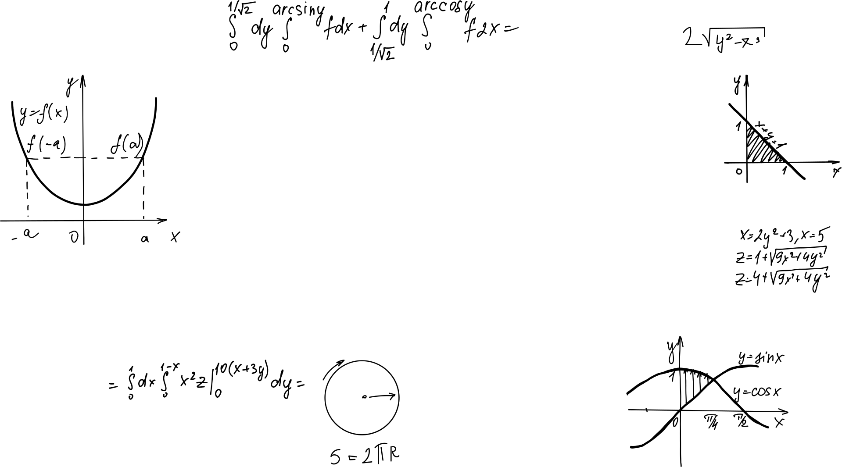

Dimensionality Reduction
PCA’s Mathematical Opus
~ Hrishikesh Yadav ~

Slide 2
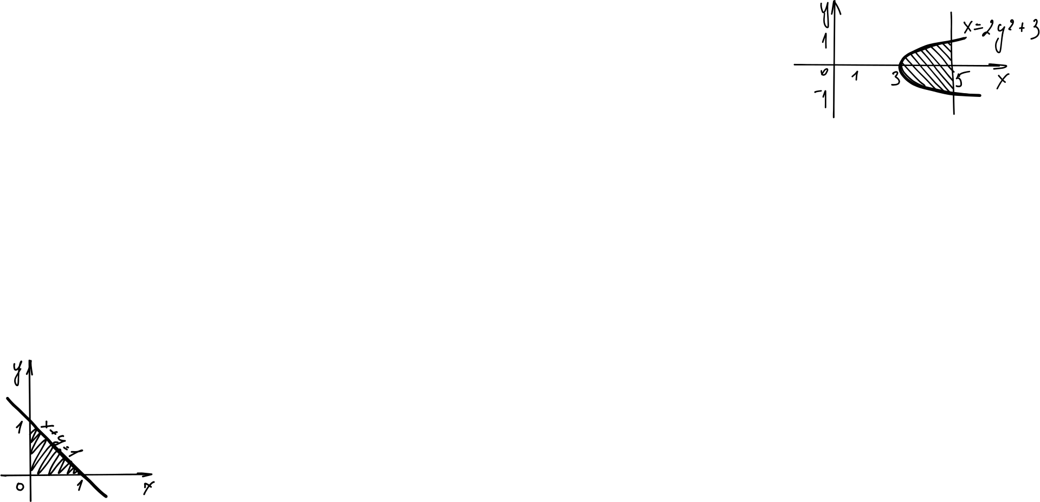
Table of contents
Real World Application
Understanding the basics around PCA
Visual Intuition of PCA
Mathematics behind the Magic
Tips and Tricks
Hands-On with PCA
Applying PCA
QnA

Slide 3



ABOUT
AI Engineer @ShagaLabs
Kaggle 2x Expert
Applied Gen AI Researcher
Member @SuperTeamDao

Slide 4
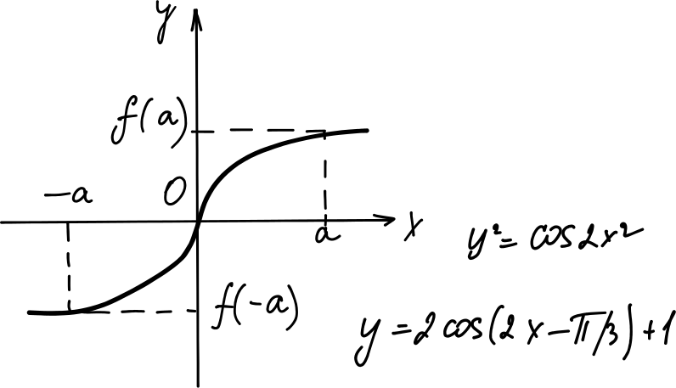
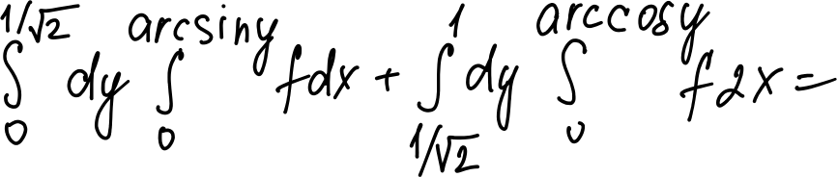

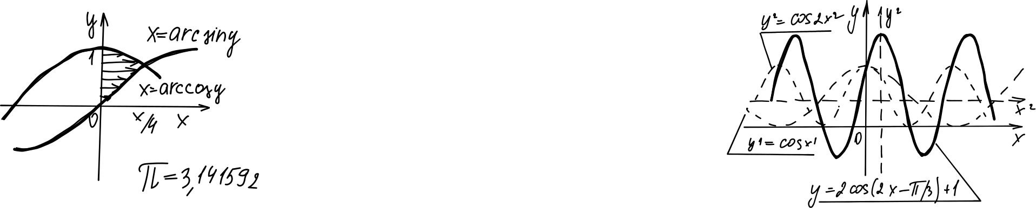

Slide 5
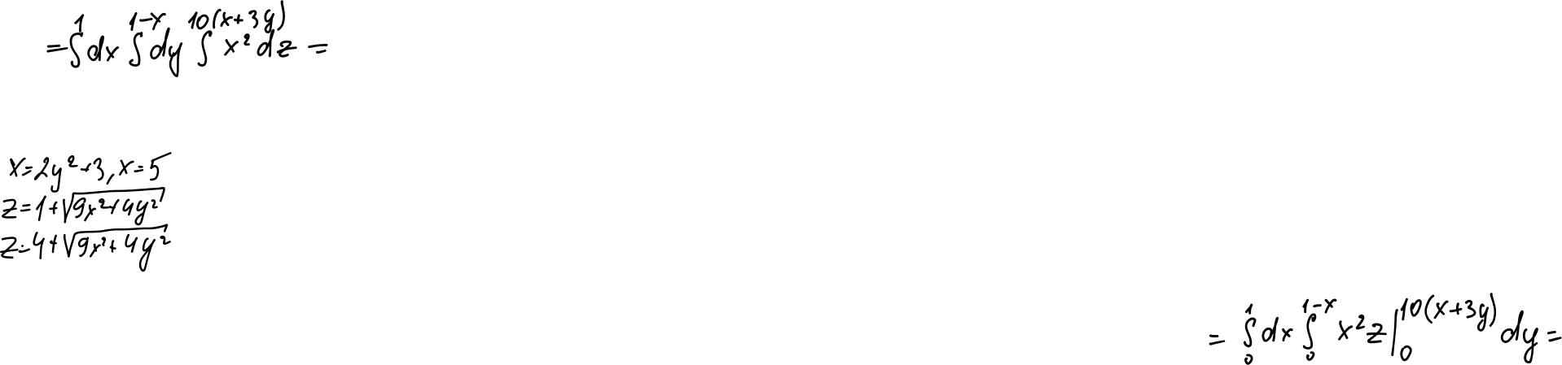
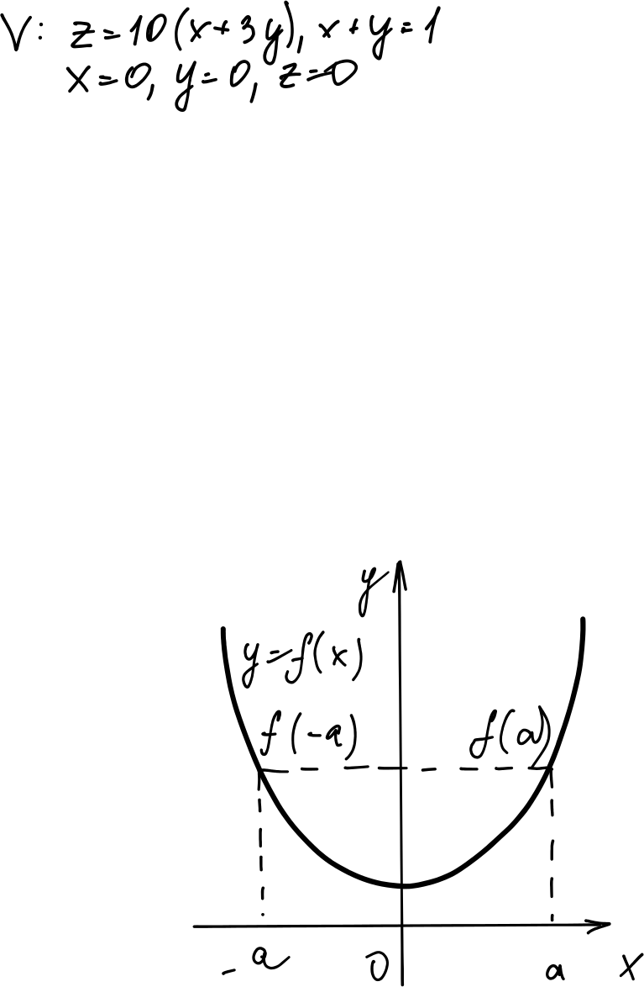
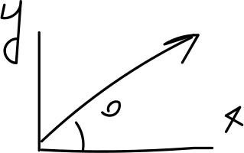
01
Real World Application

Slide 6
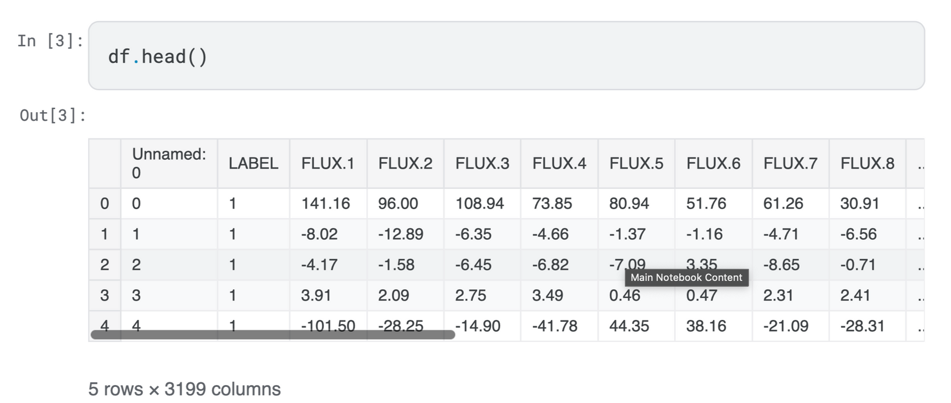
Real World Application
Exoplanet Habitabillity Classification via Flux Point

Slide 7
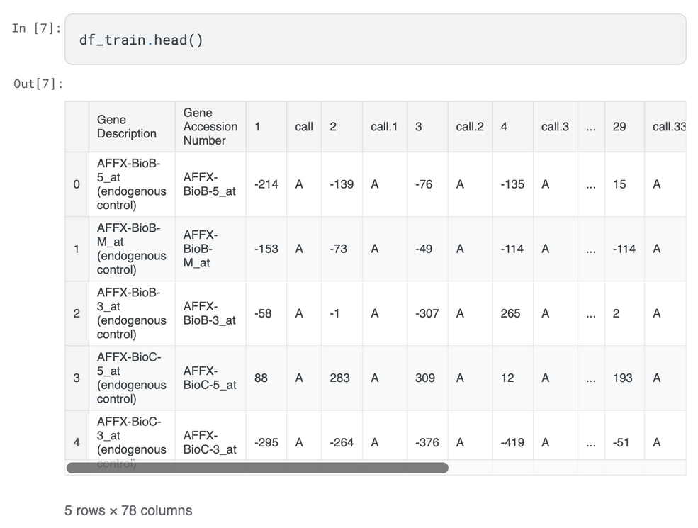
Real World Application
Class Discovery and Class Prediction by Gene Expression Monitoring

Slide 8
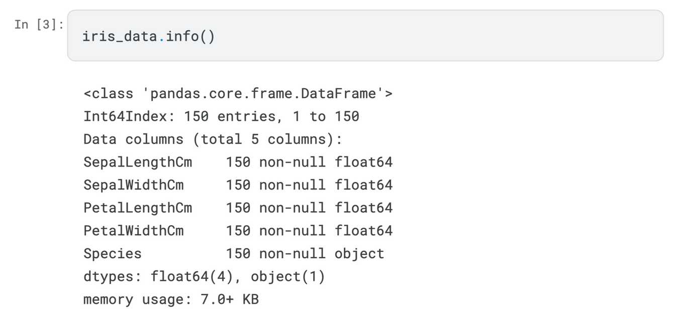
Real World Application
Iris Data Classification

Slide 9


Slide 10
02
Understanding the basics around PCA

Slide 11
What is Dimension ???
A measurable aspect or feature of data
Each variable in a dataset is a dimension
Example - Height, weight, age are 3 dimensions of person data
High dimensional data has many variables

Slide 12


Slide 13
What does Dimensionality Reduction does?
Simplifies complex data
Reduces data size while keeping important information
Helps visualize high-dimensional data
Removes noise and redundant features
Speeds up machine learning algorithms

Slide 14
Prinicipal Component
The Principal Components are a straight line that captures most of the variance of the data.
The principal component line is the vector (magnitude and the direction)
Principal components are orthogonal projections (perpendicular) of data onto lower-dimensional space..

Slide 15
03
Visual Intitution of PCA

Slide 16
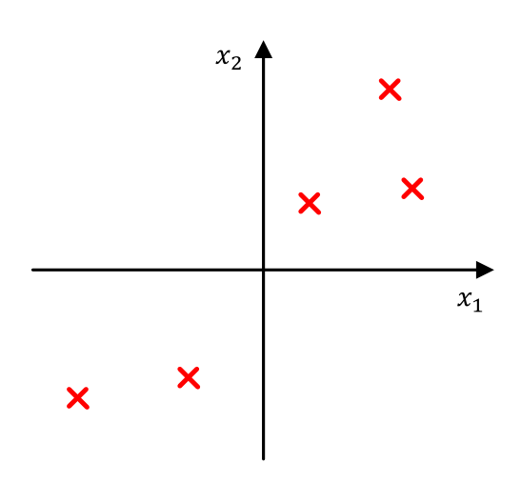
Problem Formulation
Onto which direction it is better to project the data?

Slide 17
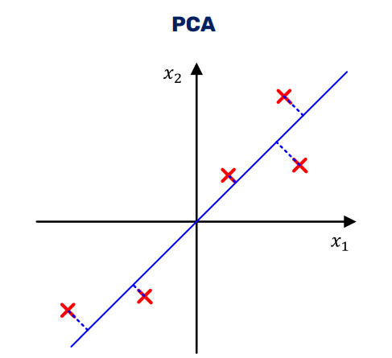
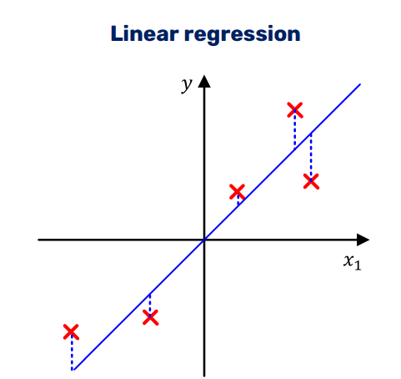
Problem Formulation

Slide 18
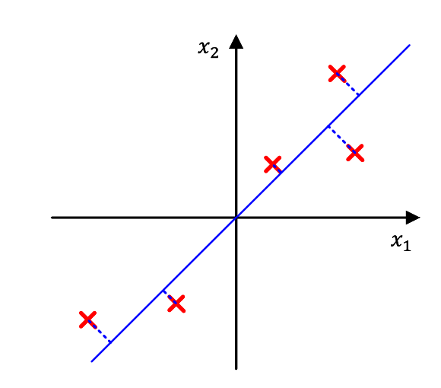
Problem Formulation
Pick the direction which minimizes the projection error.

Slide 19
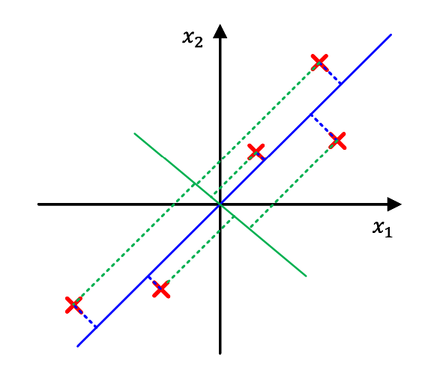
Problem Formulation
This direction is also that on which the data vary the most

Slide 20
04
Mathematics behind the Magic

Slide 21
PCA Algorithm
Input
𝑞 - the number of dimensions to retain (can be 𝑞 = 𝑑)
The training set 𝒟 = 𝒙 1 , 𝒙 2 , … , 𝒙 𝑁 , 𝒙 ∈ ℝ𝑑

Slide 22
PCA Algorithm
Data Processing
Remove the feature (column) mean for each column of the data matrix 𝑋 ∈ ℝ𝑁×𝑑
Each feature now has mean 0 and standard deviation 1.
Standardize each feature element for the respective feature standard deviation.
Define the normalized data matrix.

Slide 23
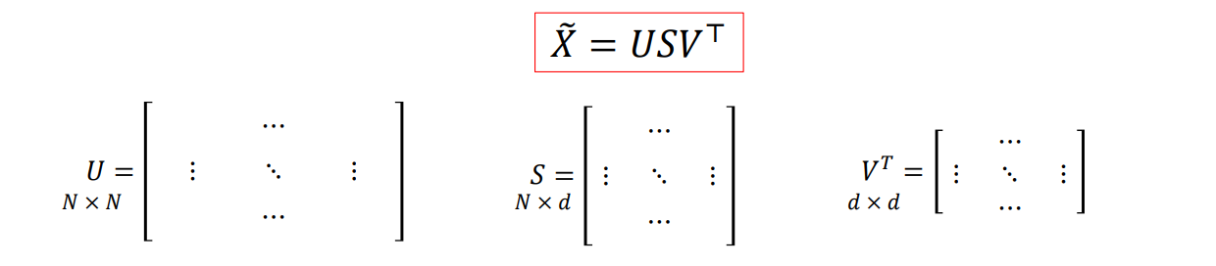
PCA Algorithm
Singular Value Decomposition
Perform a Singular Value Decomposition (SVD) of the matrix 𝑋෨ ∈ ℝ𝑁×𝑑

Slide 24
PCA Algorithm
Singular Value Decomposition
Perform a Singular Value Decomposition (SVD) of the matrix 𝑋෨ ∈ ℝ𝑁×𝑑

Slide 25
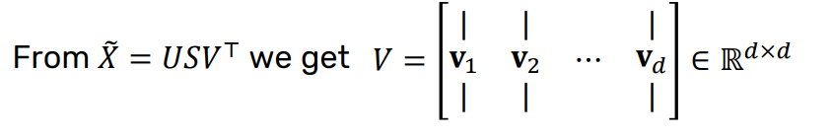
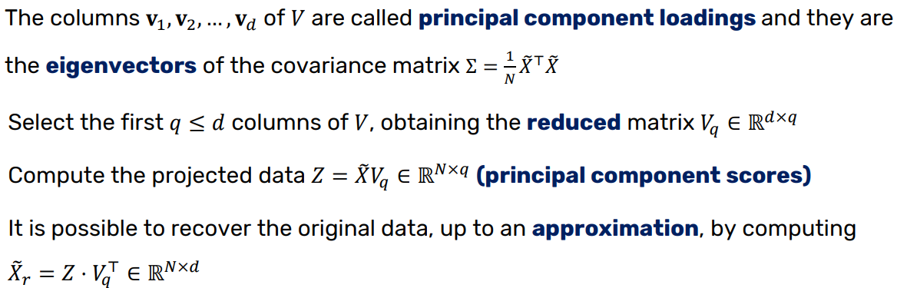
PCA Algorithm

Slide 26
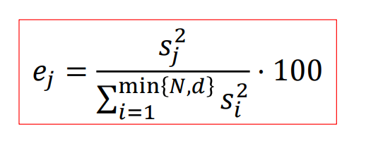
Choice of no. of Principal Component
The singular values 𝑠1, 𝑠2, … , 𝑠 <min 𝑁,𝑑>in the matrix 𝑆 can be used to compute the data variance explained by each principal component.
The percentage of variance explained by the 𝑗-th component is
Retain a number of components that explain a determined level of variance in the data
Retain a fixed number of components

Slide 27
Choice of no. of Principal Component
The singular values 𝑠1, 𝑠2, … , 𝑠 <min 𝑁,𝑑>in the matrix 𝑆 can be used to compute the data variance explained by each principal component.
The percentage of variance explained by the 𝑗-th component is
Retain a number of components that explain a determined level of variance in the data
Retain a fixed number of components

Slide 28
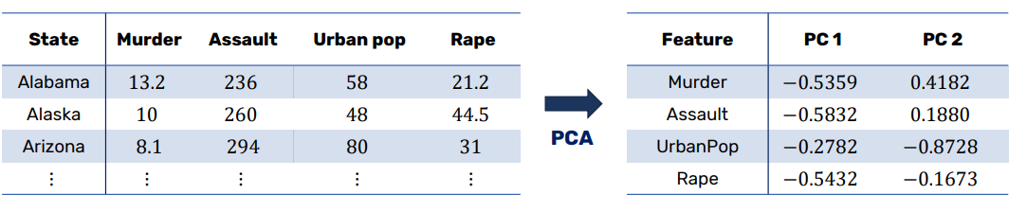
Sample
USArrest Data

Slide 29
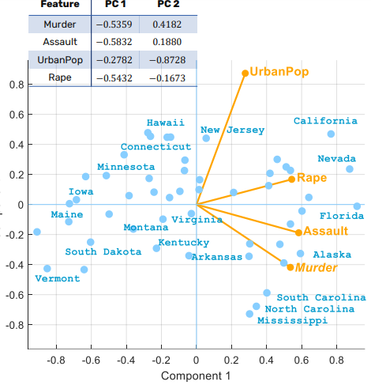
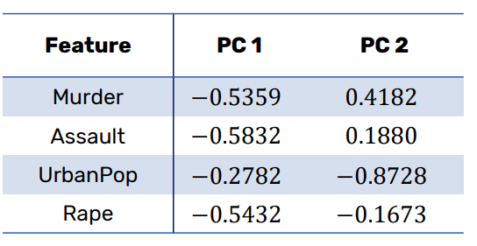
Sample

Slide 30
05
Tips and Tricks - Applying PCA

Slide 31
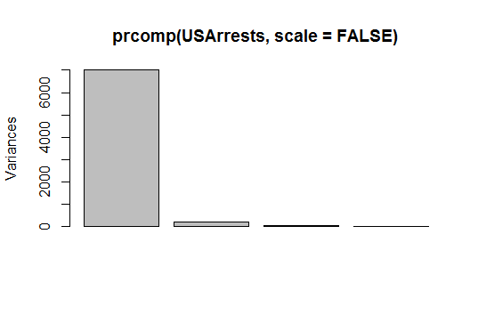
Tips and Tricks
Standardization is crucial before PCA.
Ensures all features contribute equally.
Use z-score standardization (mean=0, variance=1) or scale features to a fixed range (e.g., 0-1)

Slide 32
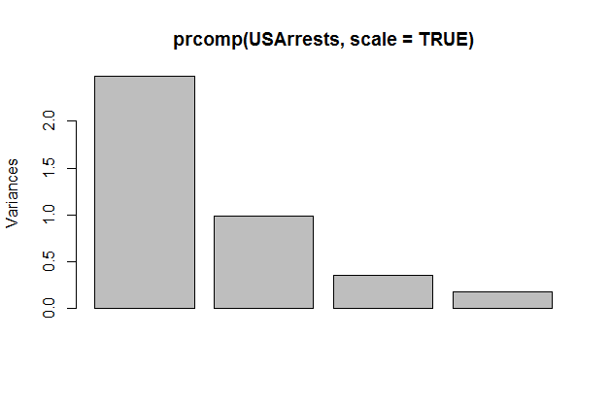
Tips and Tricks
Standardization is crucial before PCA.
Ensures all features contribute equally.
Use z-score standardization (mean=0, variance=1) or scale features to a fixed range (e.g., 0-1)

Slide 33
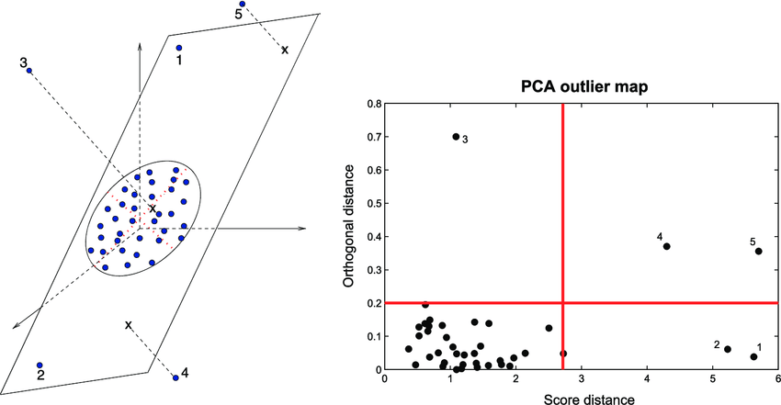
Tips and Tricks
2. PCA is sensitive to outliers - handle them first.
Identify and remove or transform outliers.
Consider robust PCA techniques for noisy data.
Use visualization tools to spot outliers in high dimensions.

Slide 34
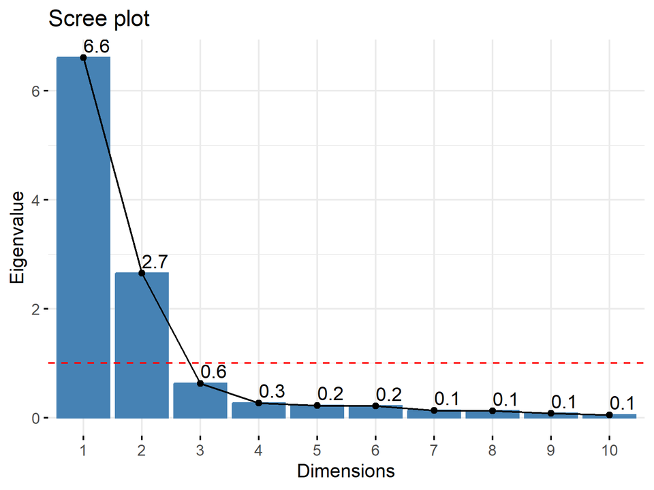
Tips and Tricks
3. Use scree plot to choose number of components.
Plot eigenvalues against component number.
Look for "elbow" point where curve levels off.
Components before elbow explain most variance

Slide 35
Tips and Tricks
4. Tradeoff Information
Set a threshold (e.g., 80% or 90%).
Keep components that cumulatively explain this much variance Balance between dimensionality reduction and information retention

Slide 36
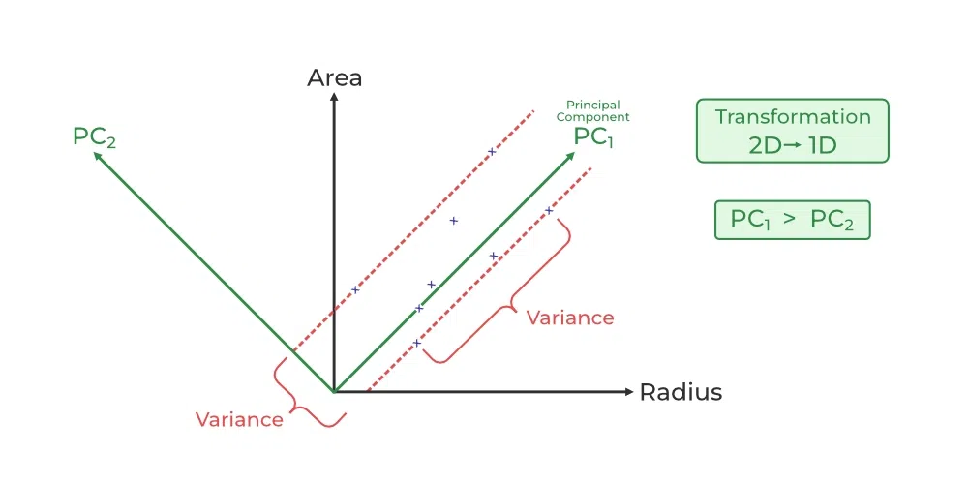
Tips and Tricks
5. Use PCA for feature engineering, not just reduction.
Create new features from top principal components.
Combine with original features for better model performance.
Useful in image processing and signal analysis

Slide 37
06
Applying PCA Hands-On

Slide 38
Applying PCA Hands-On
https://www.kaggle.com/code/hrishikeshyadav/pca-starter-pack?scriptVersionId=188642215

Slide 39

ABOUT
AI Engineer @ShagaLabs
Kaggle 2x Expert
Applied Gen AI Researcher
Member @SuperTeamDao
Twitter - @hrishikesh_ai

Slide 40
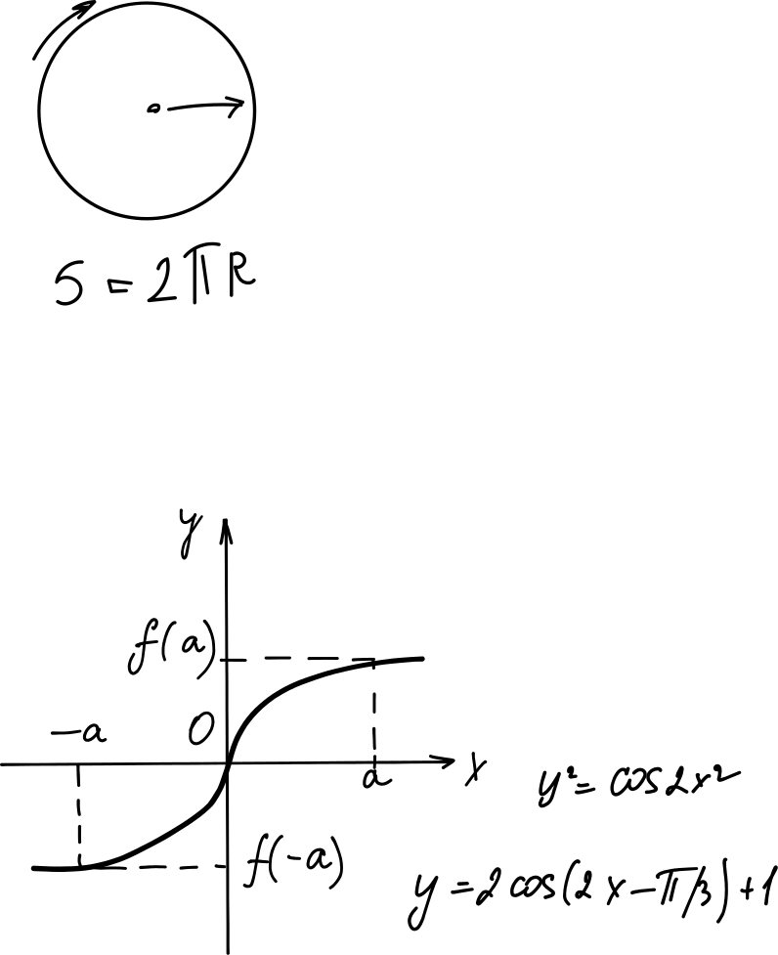
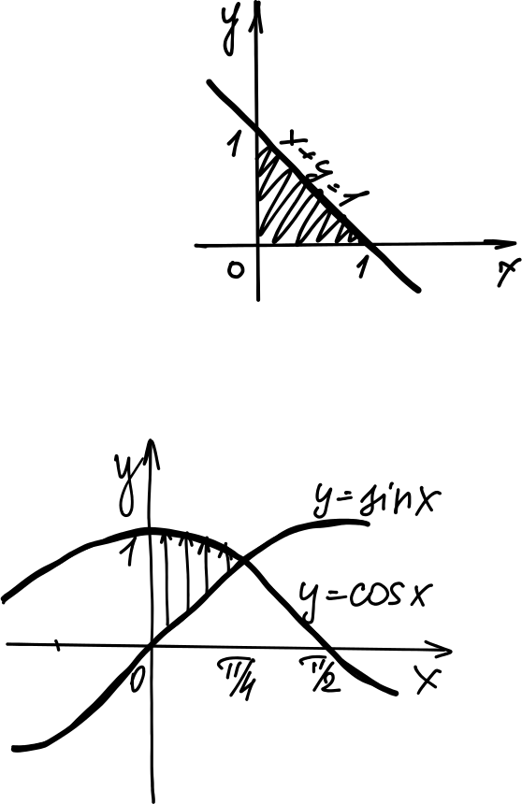

Thanks!
CREDITS: This presentation template was created by Slidesgo, and includes icons by Flaticon and infographics & images by Freepik

